Slide 1
Domain Deep Learning
Technology: Python
Paddy Crop Disease Prediction- A Transfer Learning Technique

Slide 2
INDEX
Abstract
Introduction
Literature review
Existing Method
Drawbacks
Proposed method
Advantages
Implementation
Applications
Hardware and Software Requirements
UML diagrams
Architecture
Results
Conclusion
References

Slide 3
ABSTRACT
Agriculture is the spinal cord of the human society because it is an essential need of every organism that exists in this planet. Paddy cultivation is very significant so far as humans are concerned, especially in the Asian subcontinent. Since the entry of the IT industry, there has been some improvement in the productivity in the agriculture. It has done a lot of work in the healthcare of the agriculture. Deep learning has helped a lot to improve the productivity of in the agriculture field.
In the recent past, due to excessive use of man made chemicals and pesticides, the diseases in plants have increased in a higher rate. These diseases in agricultural plants cannot be ignored as it can be dangerous in later stages. Also due to lack of technical knowledge, sometimes it becomes difficult to detect these diseases. So, this project presents a model for detecting the disease present in the paddy plant. The model uses transfer learning approach which is a paradigm of solving deep learning problems in an efficient manner.

Slide 4
INTRODUCTION
The agriculture sector is very significant for incomes of various classes throughout the world.
But there are major risks in agricultural growth, poverty reduction and food security. Frequent climatic changes and other weather factors may lead to severe reduction in yield of the crops. Climate change not only declines the growth in agriculture but also snatches the job opportunity of many farmers.
Another factor that plays a major role in destruction of agriculture is human error like adding excessive pesticides and insecticide that not only destroys a crop but also harms the biodiversity.

Slide 5
The proposed model detects what disease the plant is suffering from. It classifies the disease that the plant might be suffering from into three categories that are Hispa, brown spot and leaf blast. If the leaf is healthy then our model predicts that the leaf is healthy.
Convolutional Neural Network is chosen because of its efficiency to work with images. The data set which is chosen contains four classes out of which three are disease class and one is healthy class.
The proposed model uses image augmentation for the augmentation of the image and then trains on it to give the desired result.

Slide 6
Literature Survey
S. NO | Journal Type with year | Authors | Title | Outcomes
1 | International Journal (2018) | R. Rajmohan, M. Pajany, R. Rajesh, D. Raghuraman, U. Prabu | Crop Disease Identification using Deep Convolutional Neural Networks and SVM Classifier | Our framework intends to make development more productive as the agriculturist can settle on better educated choices and subsequently spare time and assets.
2 | International Journal (2018) | L. Barik | Survey on Region Identification of Rice Disease Using Image Processing | This presents a model for detecting the disease present in the paddy plant

Slide 7
S. NO | Journal Type with year | Authors | Title | Outcomes
3 | International Research Journal (2018) | A Badage. | Crop Disease Detection using Machine Learning: Indian Agriculture | The proposed system intimates the agriculturist about the crop diseases to take further actions
4 | Journal (2017) | A. Arumugam | A predictive modeling approach for improving paddy crop productivity using data mining techniques | The proposed research aims to develop a predictive model that provides a cultivation plan for farmers to get high yield of paddy crops using data mining techniques
5 | International Journal of Advanced Research in Electrical | S.B Dhaygude, N.P Kumbhar | “Agricultural Plant Leaf Disease Detection Using Image Processing | Using Dl techniques recognize the plate diseases names.

Slide 8
EXISTING METHOD
In existing systems, it is very difficult for the farmers to manually identify many diseases accurately with their limited knowledge. This difficulty can be overcome by using deep learning techniques.

Slide 9
DISADVANTAGES
x
It is difficult to detect and identify diseases.
Difficult to handle.
It takes more time.

Slide 10
PROPOSED SYSTEM
In proposed system, we propose a Deep Learning technologies that automatically recognizes images using Convolution Neural Network (CNN) with transfer learning models can be very beneficial in such problems. By using these techniques we can easily detect and identify the diseases.

Slide 11
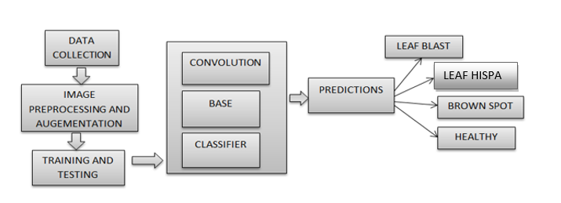
BLOCK DIAGRAM

Slide 12
ADVANTAGES
It takes less time to identify and detect the disease.
Results are accurate.
Easy to handle.

Slide 13
IMPLEMENTATION
SYSTEM
1.1 Create Dataset:
The dataset containing images of the desired objects to be recognize is split into training and testing dataset with the test size of 20-30%.
1.2 Pre-processing:
Resizing and reshaping the images into appropriate format to train our model.
1.3Training:
Use the pre-processed training dataset is used to train our model using CNN algorithm.

Slide 14
USER
2.1 Register:
The user needs to register and the data stored in MySQL database.
2.2 Login:
A registered user can login using the valid credentials to the website to use a application.
2.3 About-Project:
In this application, we have successfully created an application which takes to classify the images.

Slide 15
2.4 Upload Image
The user has to upload an image which needs to be classify the images.
2.5 Prediction
The results of our model is displayed as either Rice Blast, Leaf Hispa, Healthy & Brown Spot.
2.6 Logout
Once the prediction is over, the user can logout of the application.

Slide 16
APPLICATIONS
Agriculture sectors can implement this application for better harvest.
Scientific researches.

Slide 17
HARDWARE AND SOFTWARE REQUIREMENTS
Hardware Configuration:
Processor - I3/Intel Processor
Hard Disk -160GB
Key Board - Standard Windows Keyboard
Mouse - Two or Three Button Mouse
Monitor - SVGA
RAM - 8Gb

Slide 18
Software Configuration:
Operating System : Windows 7/8/10
Server side Script : HTML, CSS & JS
IDE : Pycharm
Libraries Used : Numpy, IO, OS, Pillow, keras.
Technology : Python 3.6+

Slide 19
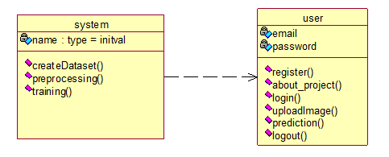
UML DIAGRAMS
CLASS DIAGRAM:
In software engineering, a class diagram in the Unified Modeling Language (UML) is a type of static structure diagram that describes the structure of a system by showing the system's classes, their attributes, operations (or methods), and the relationships among the classes. It explains which class contains information.

Slide 20
USE CASE DIAGRAM:
A use case diagram in the Unified Modelling Language (UML) is a type of behavioural diagram defined by and created from a Use-case analysis. Its purpose is to present a graphical overview of the functionality provided by a system in terms of actors, their goals (represented as use cases), and any dependencies between those use cases.

Slide 21
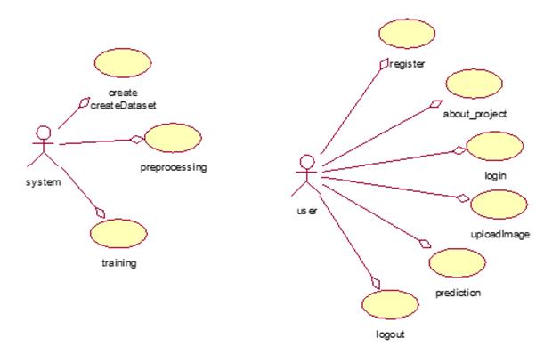

Slide 22
SEQUENCE DIAGRAM:
A sequence diagram in Unified Modelling Language (UML) is a kind of interaction diagram that shows how processes operate with one another and in what order. It is a construct of a Message Sequence Chart. Sequence diagrams are sometimes called event diagrams, event scenarios, and timing diagrams.

Slide 23
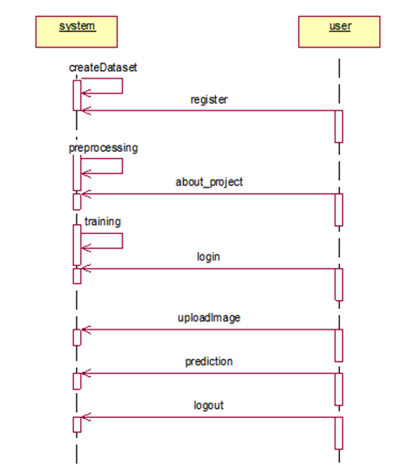

Slide 24
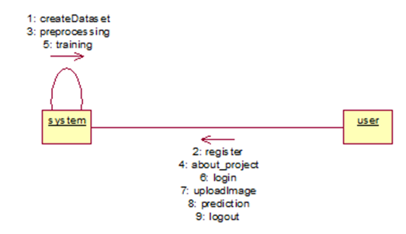
COLLABORATION DIAGRAM:
In collaboration diagram the method call sequence is indicated by some numbering technique as shown below. The number indicates how the methods are called one after another. We have taken the same order management system to describe the collaboration diagram. The method calls are similar to that of a sequence diagram. But the difference is that the sequence diagram does not describe the object organization whereas the collaboration diagram shows the object organization.

Slide 25
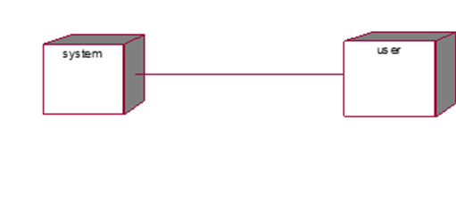
DEPLOYMENT DIAGRAM
Deployment diagram represents the deployment view of a system. It is related to the component diagram. Because the components are deployed using the deployment diagrams. A deployment diagram consists of nodes. Nodes are nothing but physical hardware’s used to deploy the application.

Slide 26
ACTIVITY DIAGRAM:
Activity diagrams are graphical representations of workflows of stepwise activities and actions with support for choice, iteration and concurrency. In the Unified Modelling Language, activity diagrams can be used to describe the business and operational step-by-step workflows of components in a system. An activity diagram shows the overall flow of control.

Slide 27
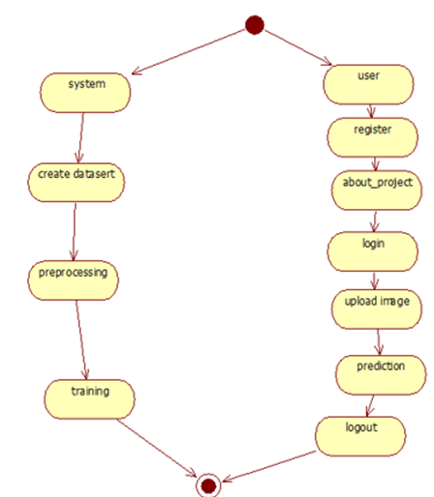

Slide 28
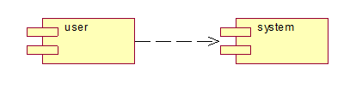
COMPONENT DIAGRAM:
A component diagram, also known as a UML component diagram, describes the organization and wiring of the physical components in a system. Component diagrams are often drawn to help model implementation details and double-check that every aspect of the system's required functions is covered by planned development.

Slide 29
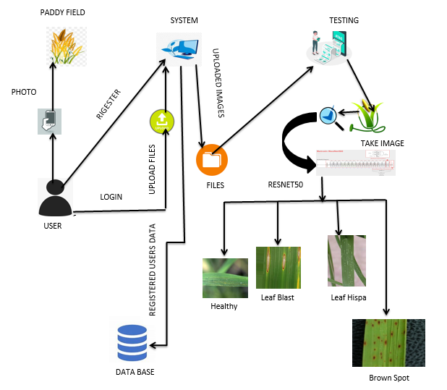
ARCHITECTURE

Slide 30

RESULTS
Home page:

Slide 31
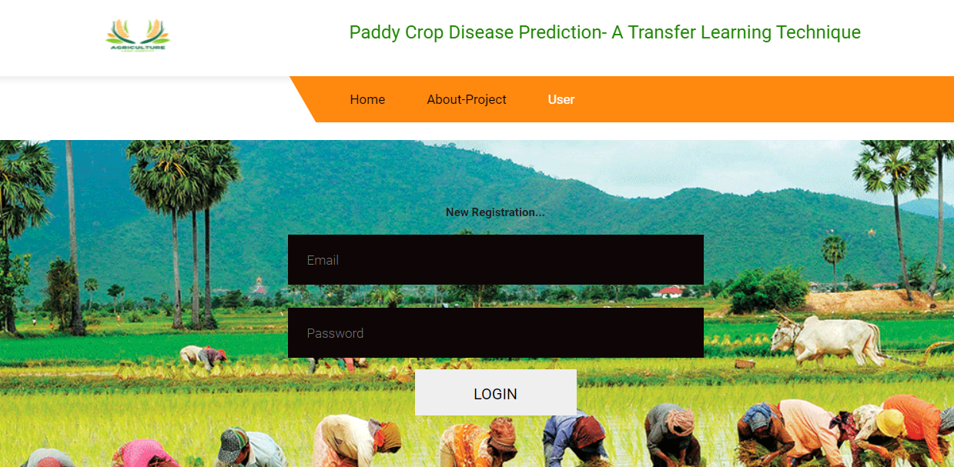
User Login Page:

Slide 32
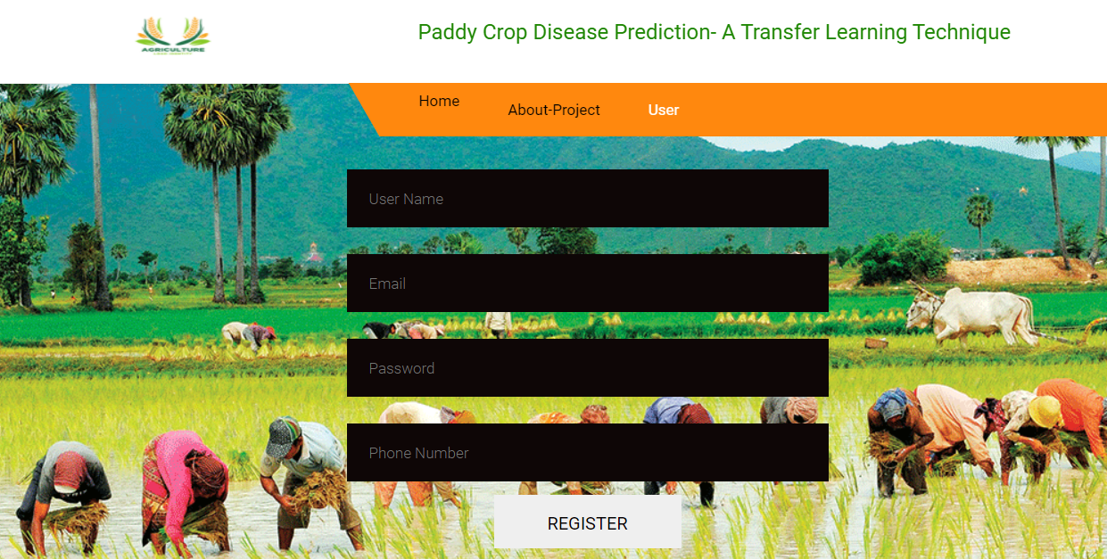
User Registration Page:

Slide 33
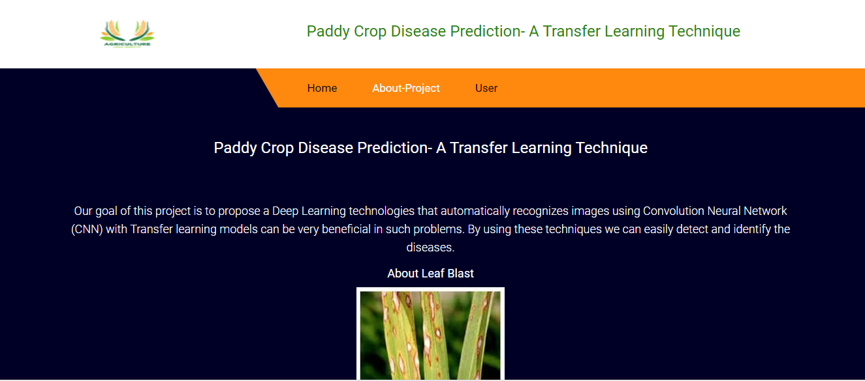
ABOUT THE PROJECT:

Slide 34
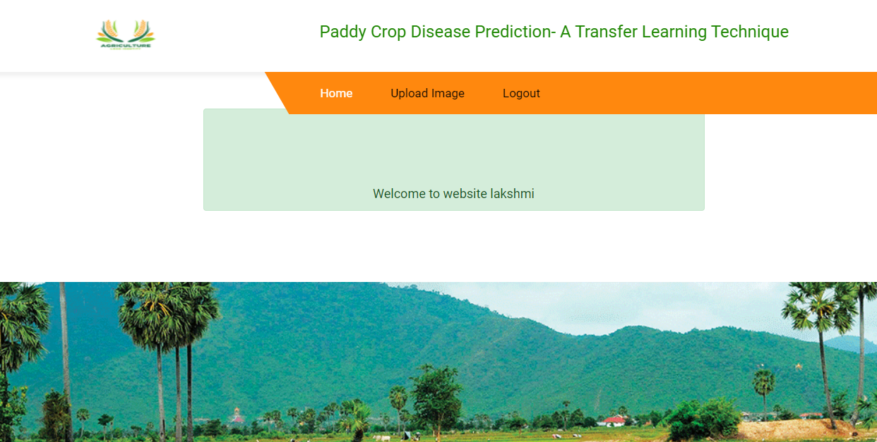
User Home Page:

Slide 35
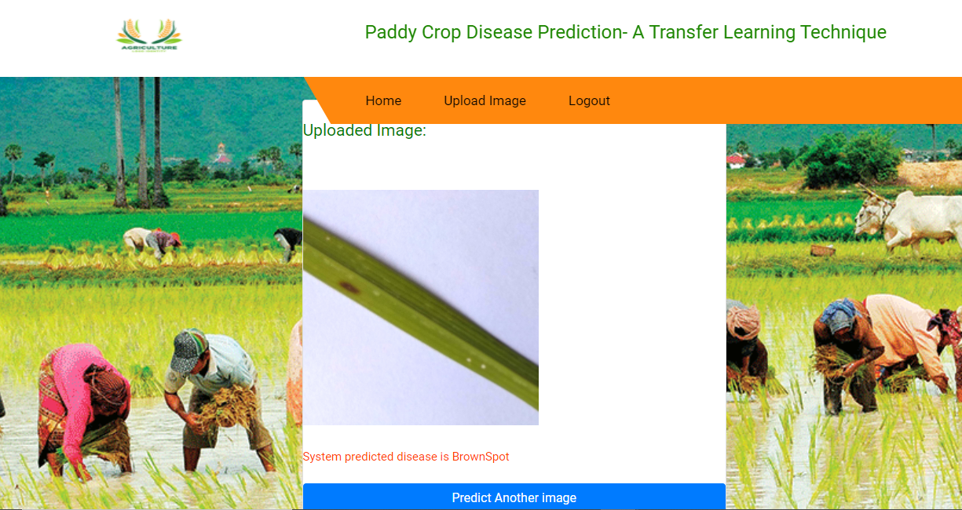
System predicted disease is Brown Spot:

Slide 36
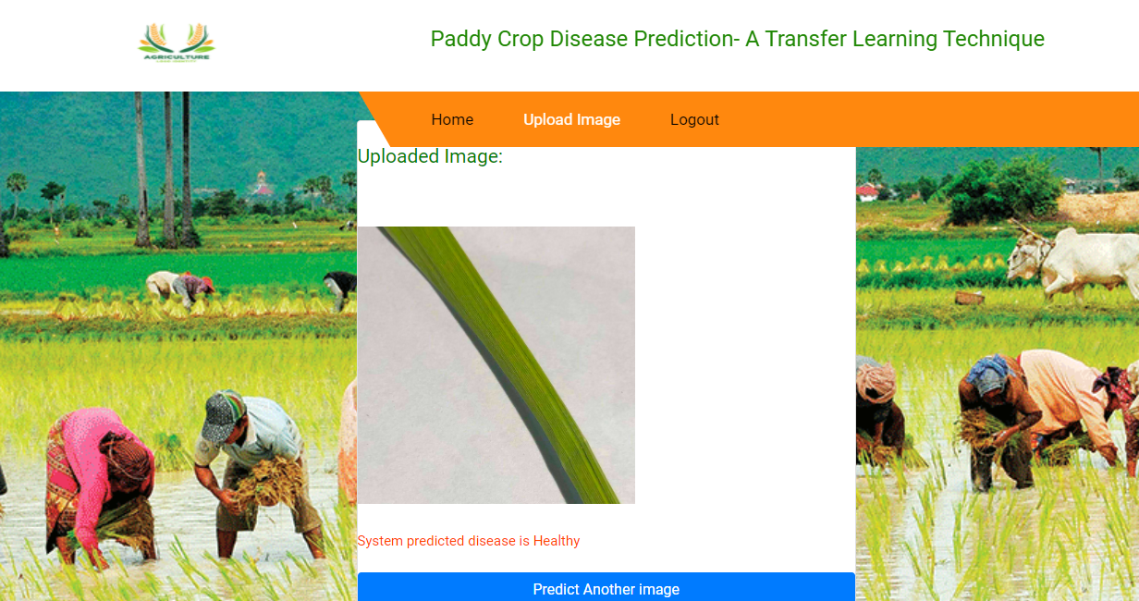
System predicted disease is Healthy:

Slide 37
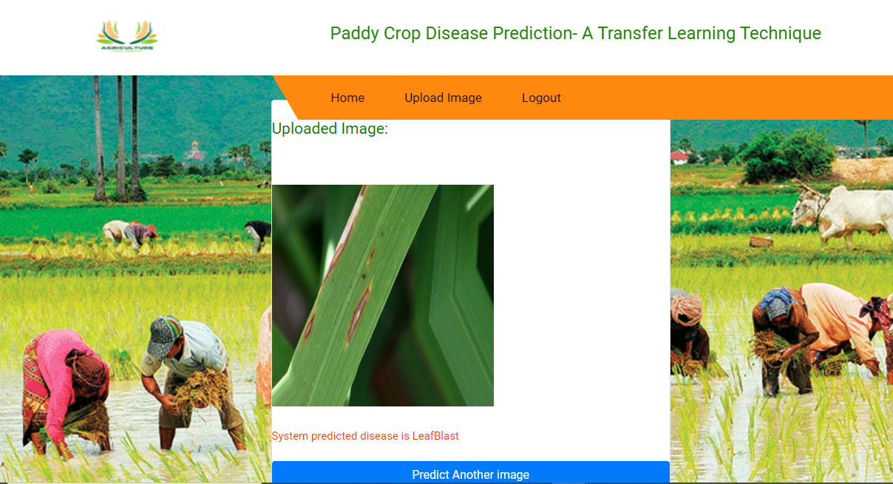
System predicted disease is Leaf Blast:

Slide 38
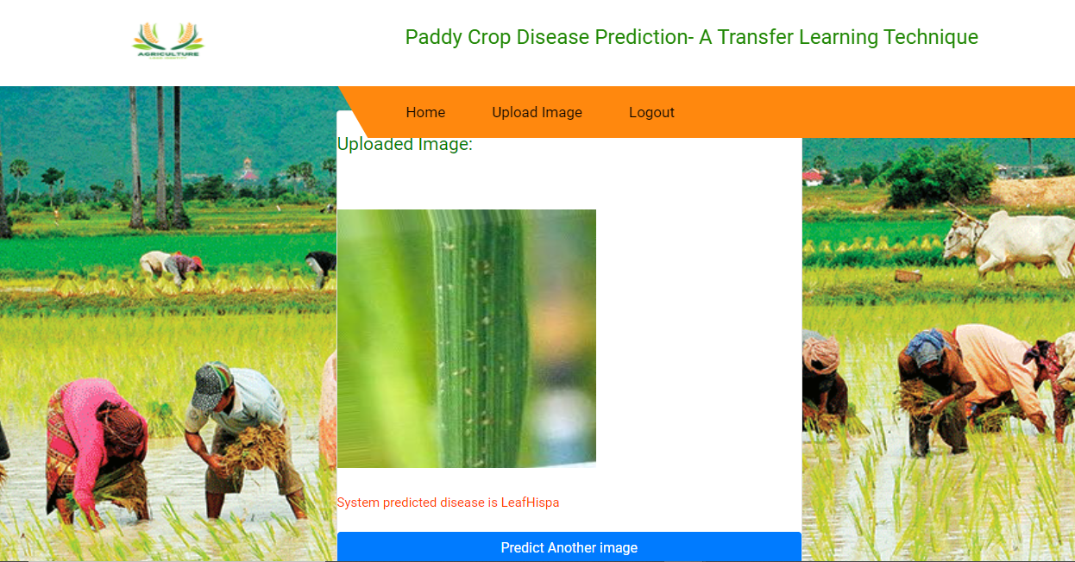
System predicted disease is LeafBlight:

Slide 39
CONCLUSION
Cultivation plays a vital role in the lives of people. It provides means of employment to human beings as well as provides food to humans and animals. As agriculture is important for humans and animals to survive, so it must be protected and preserved. Lack of technical skills and knowledge in the agriculture domain may cause severe issues related to plant’s health.
Huge involvement of IT industry in the field of agriculture in the last few years has changed the process of detection and diagnosis of various fatal diseases. This model uses transfer learning which is a technique for solving complex image processing problems in an efficient and elegant manner.

Slide 40
REFERENCES:
[1] I.S. Suraksha, B. Sushma, R.G. Sushma, K. Susmitha, S.V. Uday Shankar, “Disease Prediction of Paddy Crops using Data Mining and Image Processing Techniques”, International Journal of Advanced Research in Electrical, Electronics and Instrumentation Engineering, Vol. 5, Issue.
[2] May 2016. 6. R. Rajmohan, M. Pajany, R. Rajesh, D. Raghuraman, U. Prabu, “Crop Disease Identification using Deep Convolutional Neural Networks and SVM Classifier”, International Journal of Pure and Applied Mathematics Vol. 118, No. 15(2018)
[3] L. Barik, “Survey on Region Identification of Rice Disease Using Image Processing”, International Journal of Research and Scientific Innovation Vol. 5 Issue 1(2018)

Slide 41
REFERENCES:
[4] A Badage. “Crop Disease Detection using Machine Learning: Indian Agriculture”, International Research Journal of Engineering and Technology Vol. 5 Issue. 9 (2018)
[5] K. Jagan Mohan, M Balasubramanian, S Palanivel , “Detection and Recognition of Diseases from Paddy Plat Leaf”, International Journal of Computer Applications Vol. 144 No. 12(2016).

Slide 42


